Slide 1
Sakiyama Tami (1954-) “Swinging, Swaying” (2003)
崎山多美
ゆらていくゆりていく

Slide 2
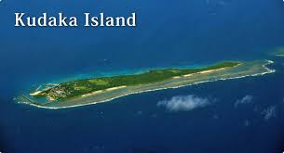
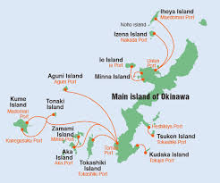
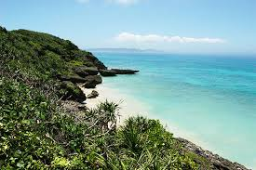
Kudaka Island?

Slide 3
Keywords
Hotara Island: origin, history, future
Orality “So it has been told”; hintaku yuntaku
Ôshiro Tatsuhiro, Panarinusuma gensô (1969)
Aging, reproduction, abandonment (hotarakasu)
Sound and language
Bubble dance
Men/women
Islanders/drifters
Notes:
According to Chūzan Seikan, the Heavenly Emperor (天帝), who lived in the Heavenly Gusuku (天城), ordered Amamikyu (阿摩美久) to create the Ryukyu Islands. She descended to Earth on the spot of Sefa-utaki, and later built Tamagusuku Castle and Chinen Castle. Without sexual intercourse, she became pregnant by Shinerikyu, her male counterpart, and populated the islands. Some generations later, a "heavenly grandchild" named Tentei was born, who split Ryukyuan society into five classes with his three sons and two daughters: the first son was Tenson, who became the first King of Ryukyu; the second son became the first Aji; the third son became the first farmer; the first daughter became the first royal noro priestess; and the second daughter became the first village noro priestess.

Slide 4
Discussion Questions
What kind of island is Hotara?
Discuss the story’s narrative structure. Why do you suppose the author chooses to tell the story the way she does?
What is the effect of the story’s incorporation of sound and local language on you as a reader?
Why would an author deliberately seek to disorient her readers? What is Sakiyama attempting to do in her island literature?

